Slide 1
FLIGHT PRICE PREDICTION PROJECT
By – Harsh Prasad

Slide 2
Problem Statement
Anyone who has booked a flight ticket knows how unexpectedly the prices vary. The cheapest available ticket on a given flight gets more and less expensive over time. This usually happens as an attempt to maximize revenue based on -
1. Time of purchase patterns (making sure last-minute purchases are expensive)
2. Keeping the flight as full as they want it (raising prices on a flight which is filling up in order to reduce sales and hold back inventory for those expensive last-minute expensive purchases)
So, you have to work on a project where you collect data of flight fares with other features and work to make a model to predict fares of flights.

Slide 3
Problem Statement
Data collection:
You have to scrape at least 1500 rows of data. You can scrape more data as well, it’s up to you, More the data better the model.
You have to scrape the data of flights from different websites (yatra.com, skyscanner.com, official websites of airlines, etc). The number of columns for data doesn’t have limit, it’s up to you and your creativity. Generally, these columns are airline name, date of journey, source, destination, route, departure time, arrival time, duration, total stops and the target variable price. You can make changes to it, you can add or you can remove some columns, it completely depends on the website from which you are fetching the data.

Slide 4
Problem Statement
Data Analysis:
After cleaning the data, you have to do some analysis on the data.
Do airfares change frequently? Do they move in small increments or in large jumps? Do they tend to go up or down over time?
What is the best time to buy so that the consumer can save the most by taking the least risk?
Does price increase as we get near to departure date? Is Indigo cheaper than Jet Airways? Are morning flights expensive?

Slide 5
Problem Statement
Model building:
After collecting the data, you need to build a machine learning model. Before model building do all data pre-processing steps. Try different models with different hyper parameters and select the best model.

Slide 6
Understanding
Optimal timing for airline ticket purchasing from the consumer’s perspective is challenging principally because buyers have insufficient information for reasoning about future price movements. In this project we majorly targeted to uncover underlying trends of flight prices in India using historical data and also to suggest the best time to buy a flight ticket.
Nowadays, airline ticket prices can vary dynamically and significantly for the same flight, even for nearby seats within the same cabin. Customers are seeking to get the lowest price while airlines are trying to keep their overall revenue as high as possible and maximize their profit.
Airlines use various kinds of computational techniques to increase their revenue such as demand prediction and price discrimination. From the customer side, two kinds of models are proposed by different researchers to save money for customers: models that predict the optimal time to buy a ticket and models that predict the minimum ticket price.
From the customer point of view, determining the minimum price or the best time to buy a ticket is the key issue. The concept of “tickets bought in advance are cheaper” is no longer working. It is possible that customers who bought a ticket earlier pay more than those who bought the same ticket later.

Slide 7
Understanding
Moreover, early purchasing implies a risk of commitment to a specific schedule that may need to be changed usually for a fee. The ticket price may be affected by several factors thus may change continuously.
To address this, various studies were conducted to support the customer in determining an optimal ticket purchase time and ticket price prediction.

Slide 8
Exploratory data analysis
Importing the dataset:
Importing the dataset using the “read_csv()” function of the Pandas library. This function can read a CSV file (either locally or through a URL) and also perform various operations on it.
dataset = pd.read_csv("Flight Price Dataset(in csv).csv")
Extracting the independent variable.
To extract the independent variables, we used drop function of the Pandas library.
X = dataset_new2.drop(“Price", axis = 1)
Here dataset_new2 is the data set which contains the independent and dependent variable after removing outliers and cleaning the data. Dropping the price variable from the dataset and storing it in other variable Y.

Slide 9
Exploratory data analysis
Extracting dependable variable.
To extract the dependent variables, we used following function.
Y = dataset_new2[“Price”]
Removing outliers from the data using Z score.
Splitting the data and then removing skewness.
Removing skewness from the data.
Scaling the data using standard scaler so that there is no biasness during model learning.
Using PCA and SequentialFeatureSelector for feature selection.
Splitting the data:
x_train,x_test,y_train,y_test = train_test_split(X,Y,test_size = .20,random_state = 1358)

Slide 10
Visualization

Slide 11
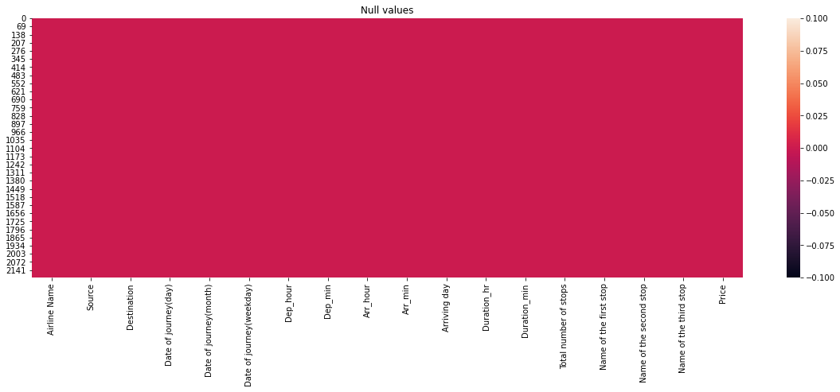
Heatmap of null values in the dataset

Slide 12
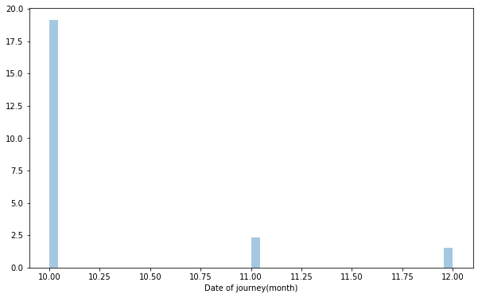
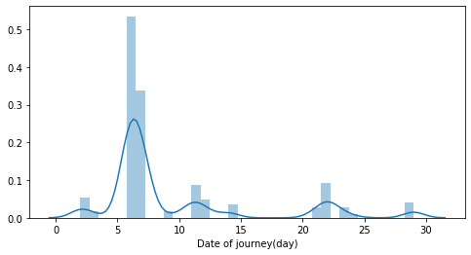
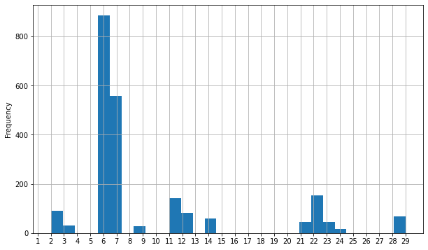
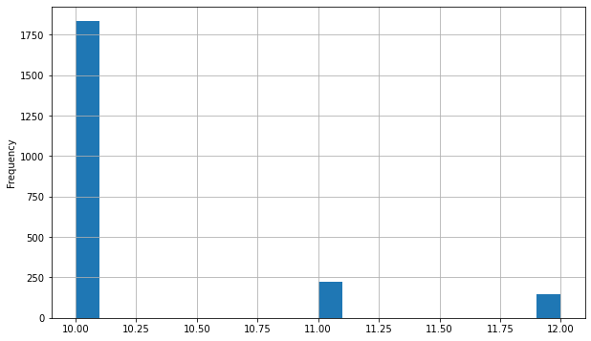
Date of journey(day)
Date of journey(month)

Slide 13
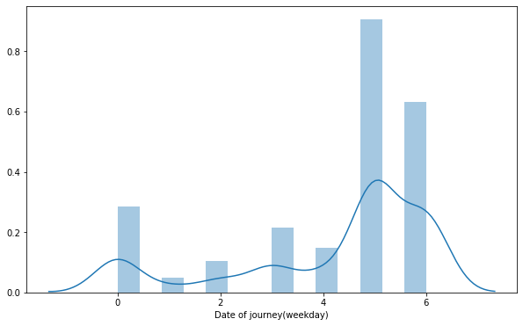
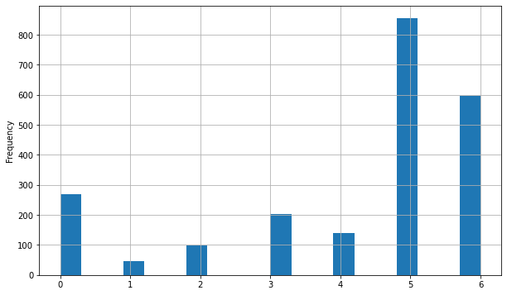
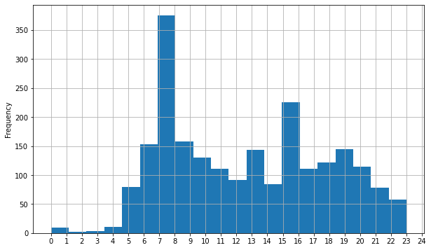
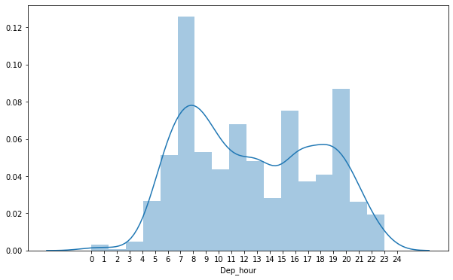
Date of journey(weekday)
Dep_hour

Slide 14
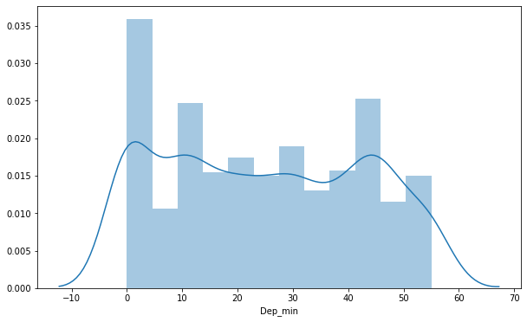
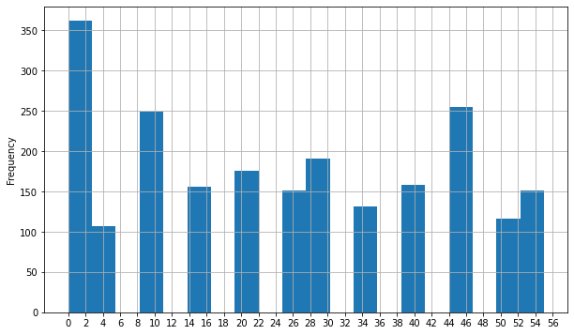
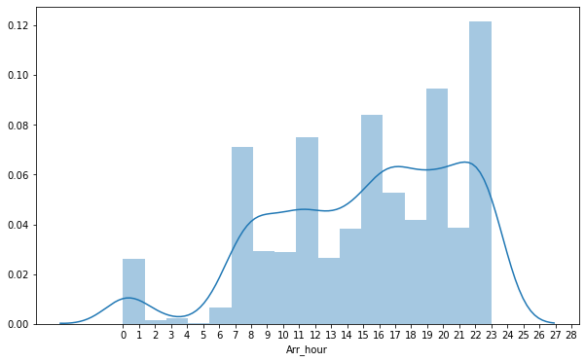
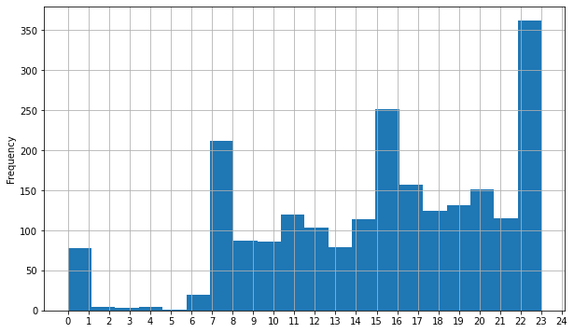
Dep_min
Arr_hour

Slide 15
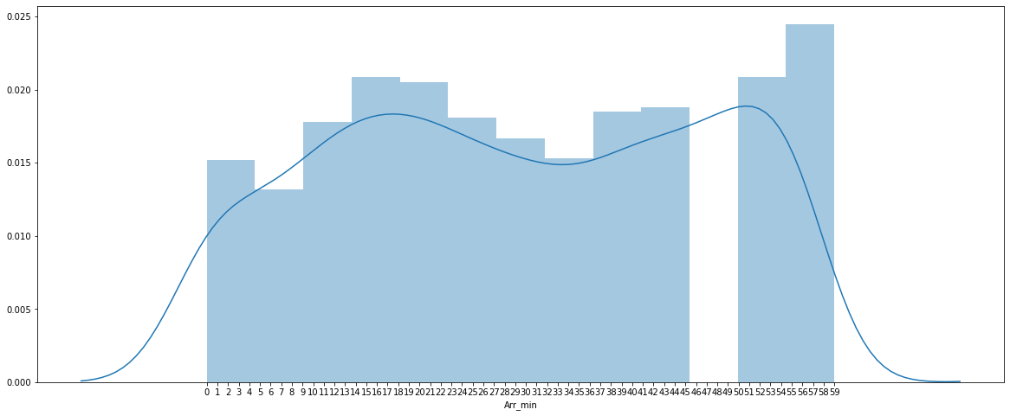
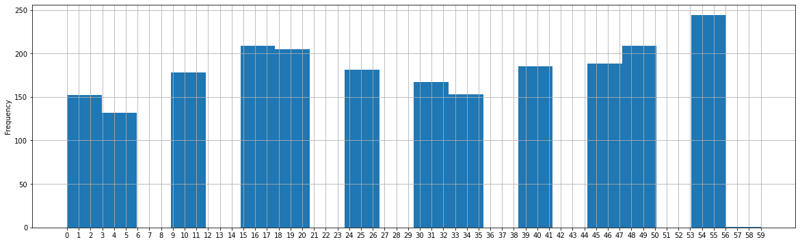
Arr_min

Slide 16
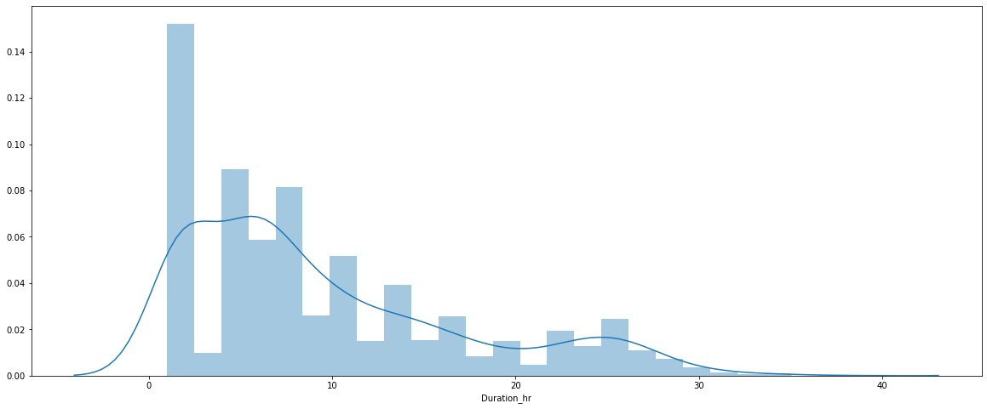
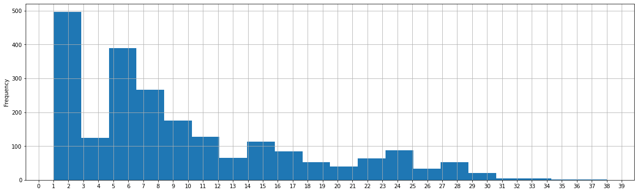
Duration_hr

Slide 17
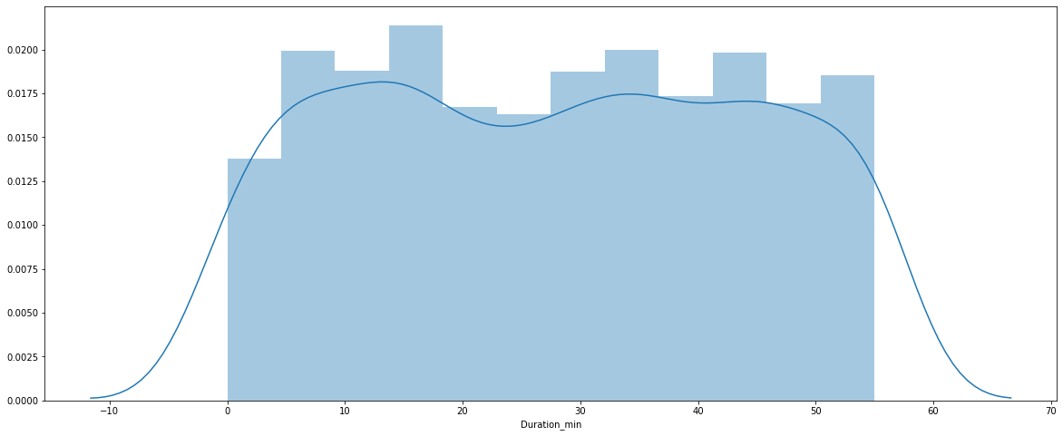
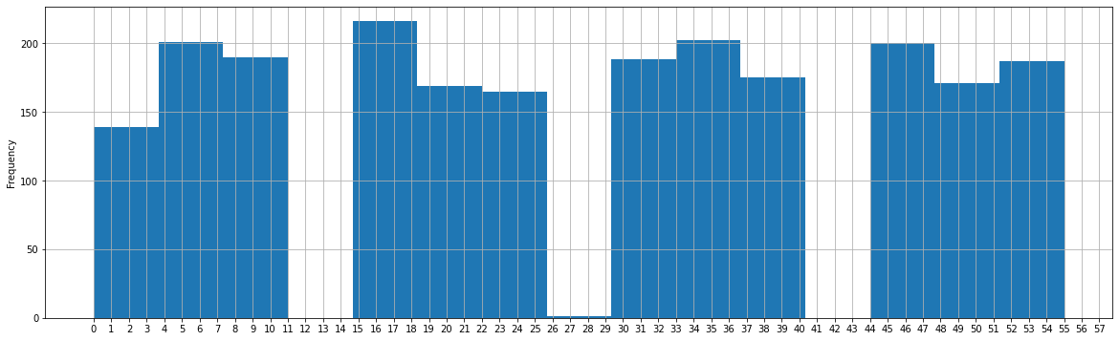
Duration_min

Slide 18
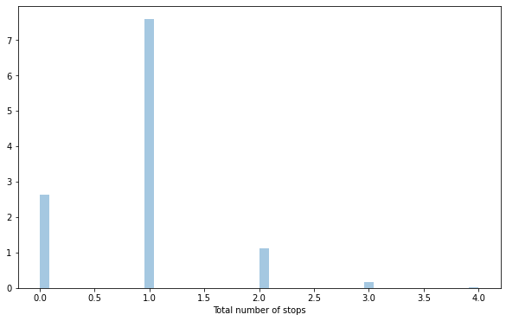
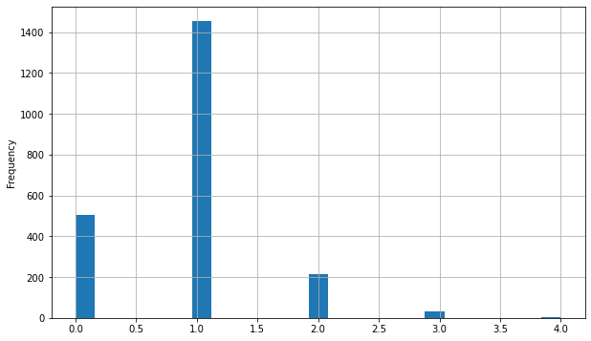
Total number of stops

Slide 19
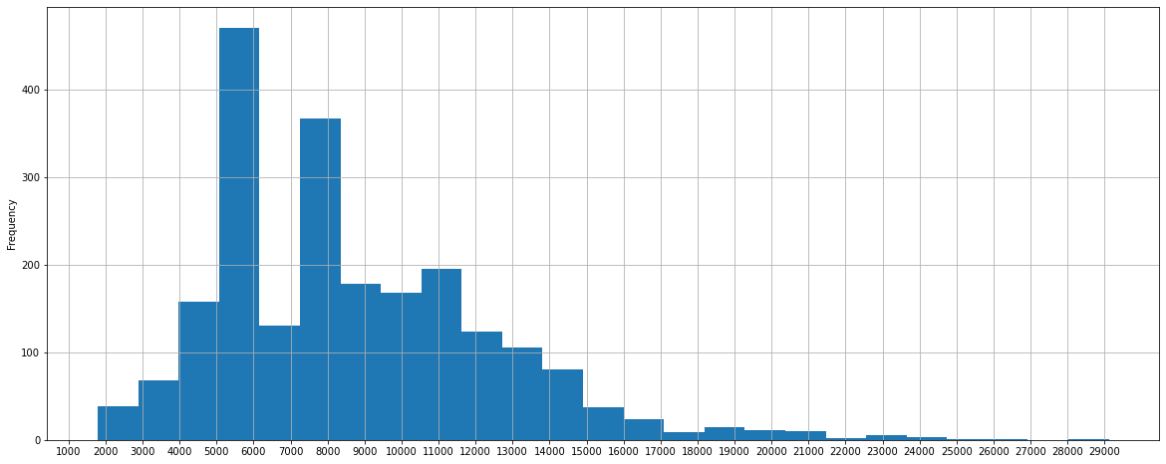
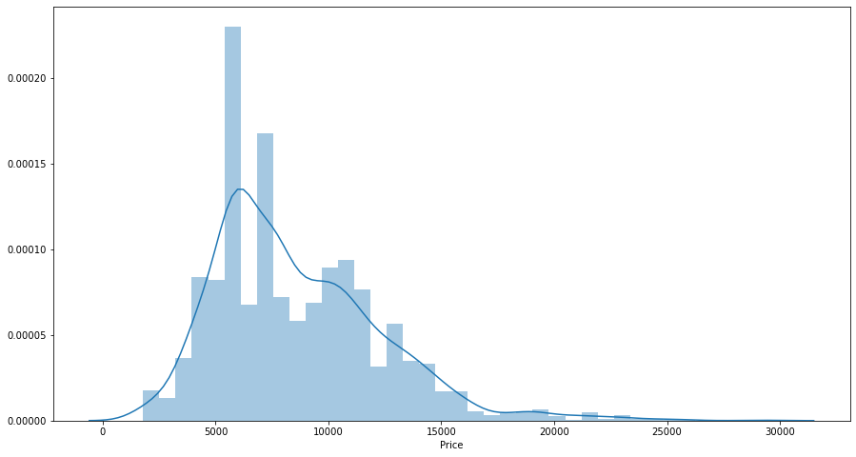
Price

Slide 20
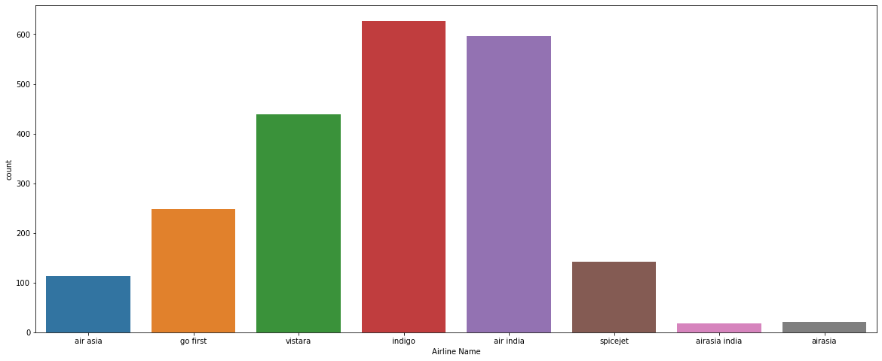
Arline Name

Slide 21
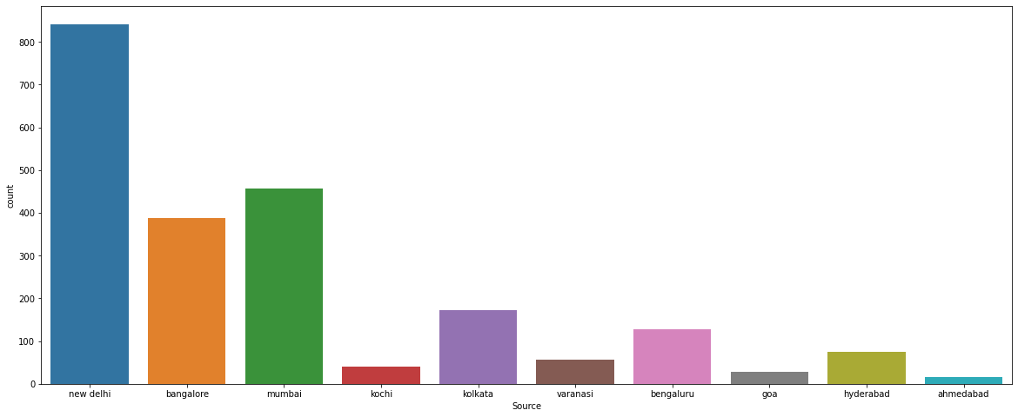
Source

Slide 22
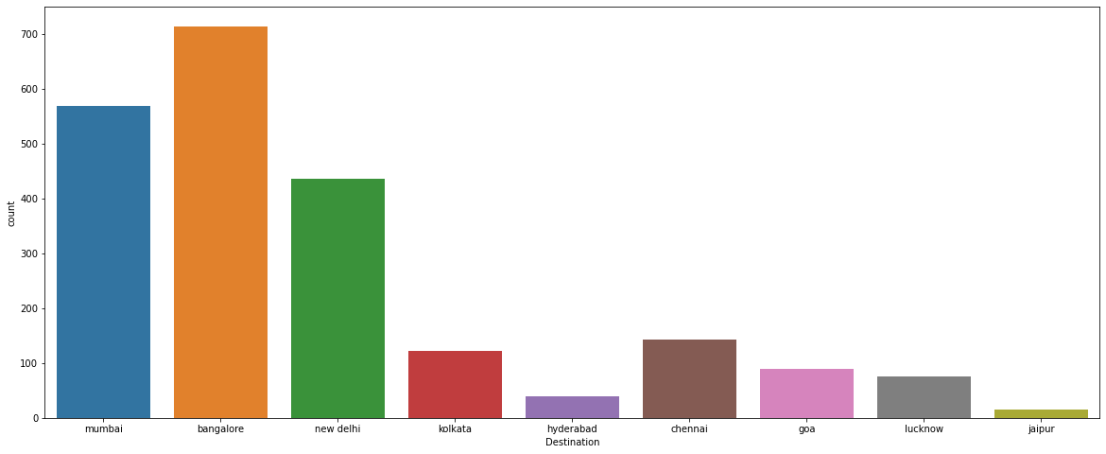
Destination

Slide 23
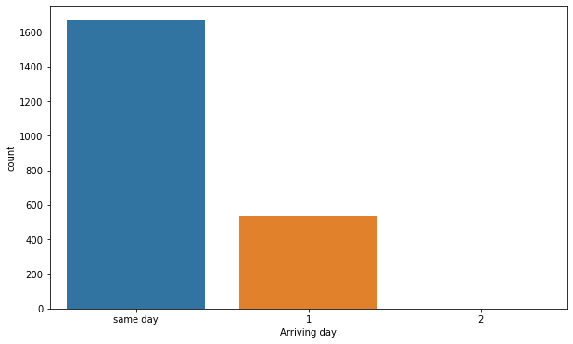
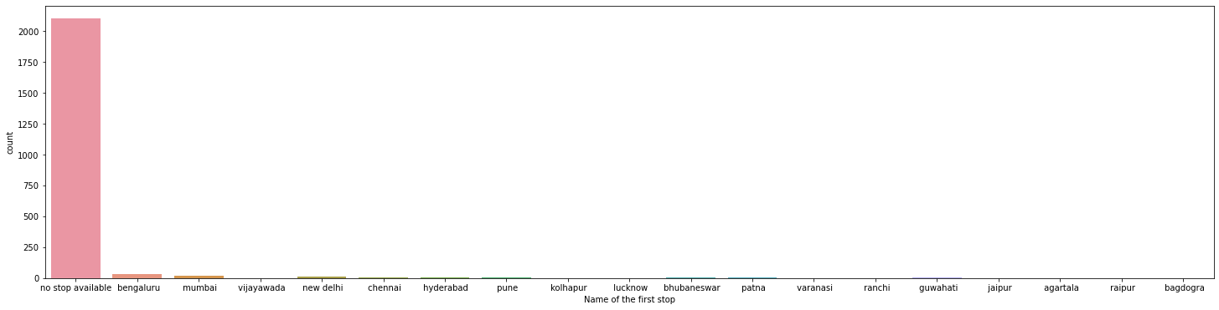
Arriving day
Name of the first stop

Slide 24
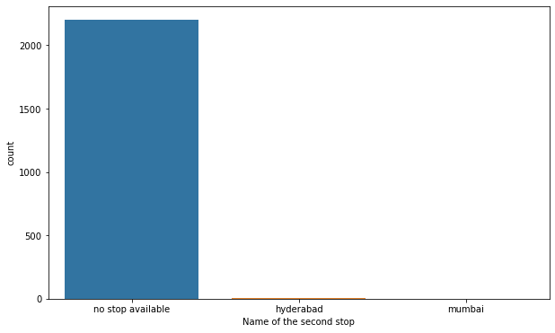
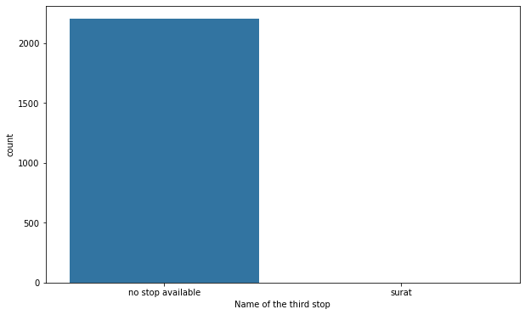
Name of the second stop
Name of the third stop

Slide 25
Heat Map(Correlation)

Slide 26
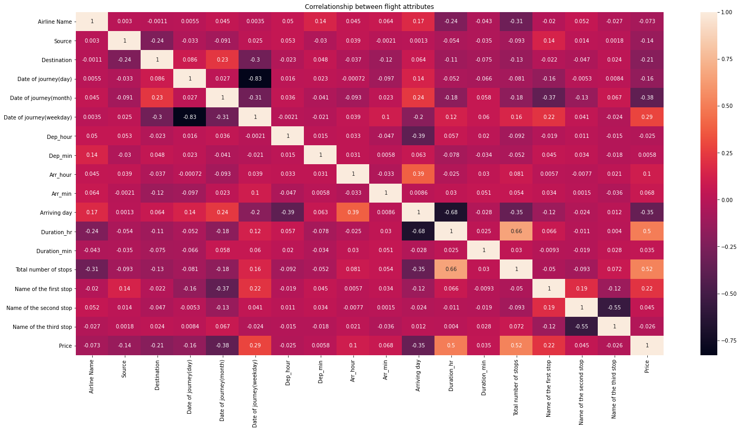

Slide 27
Relationship of the Flight price with other features.

Slide 28
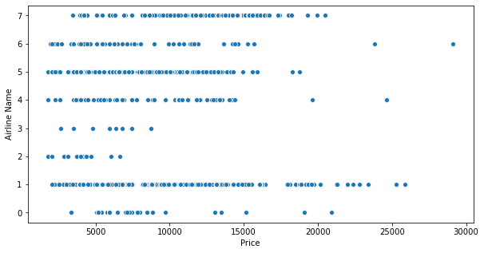
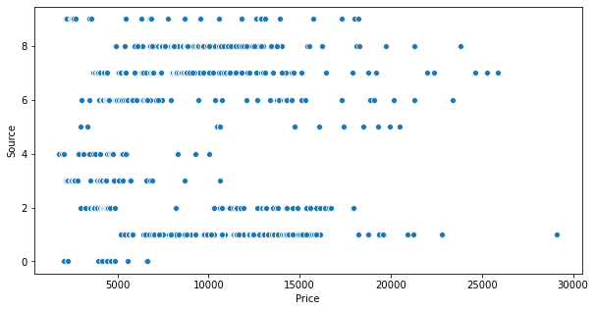
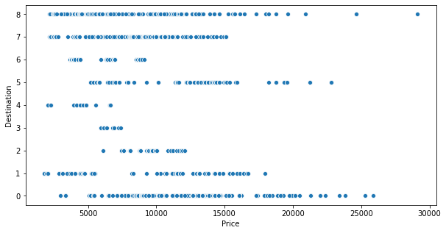
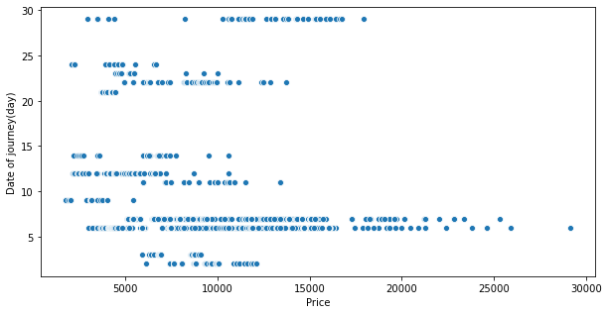

Slide 29
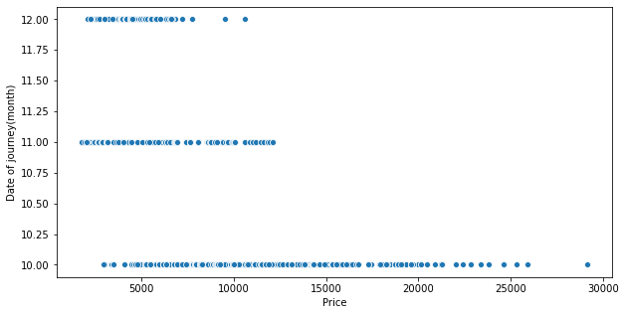
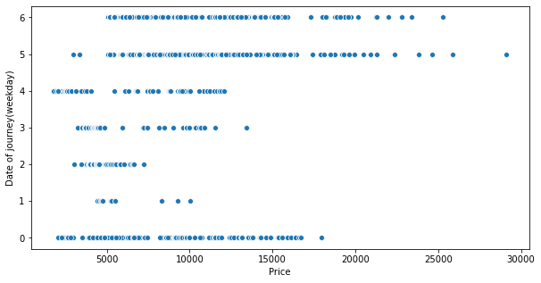
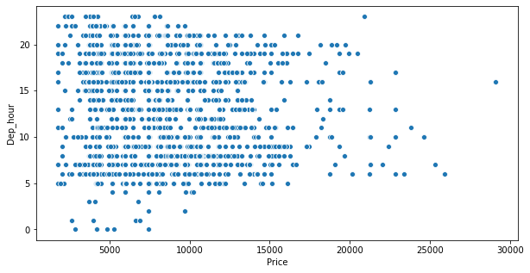
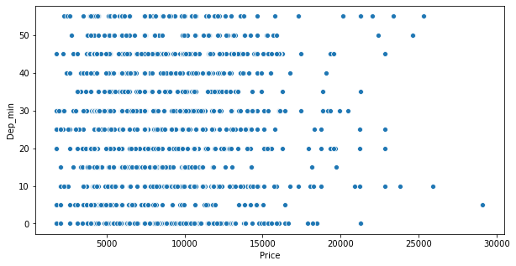

Slide 30
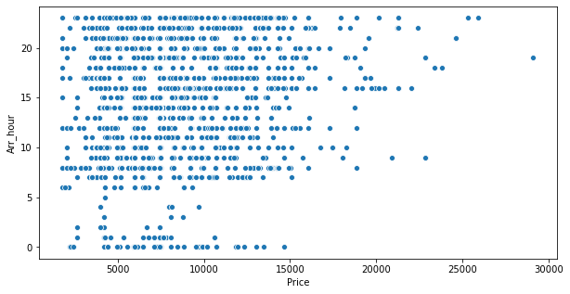
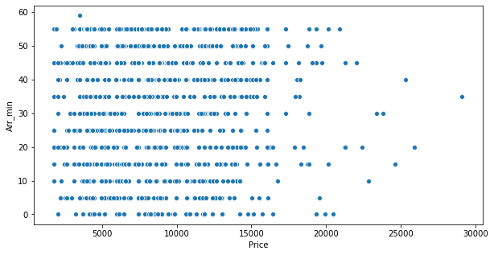
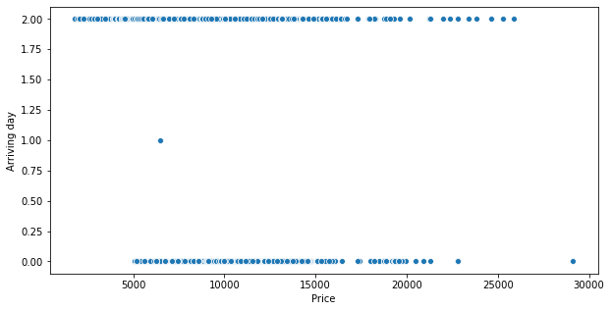
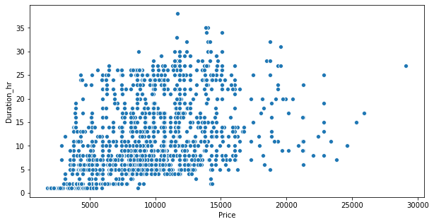

Slide 31
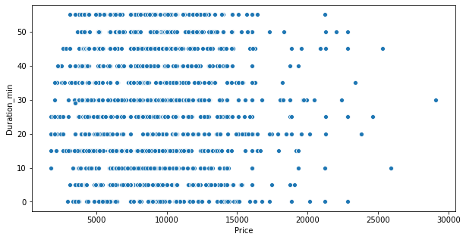
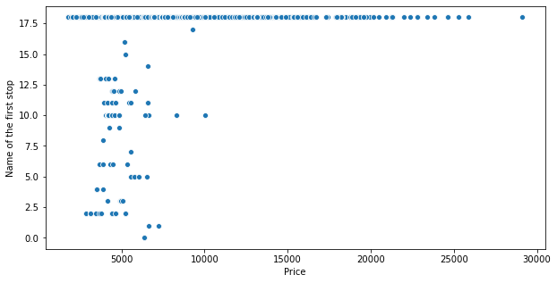
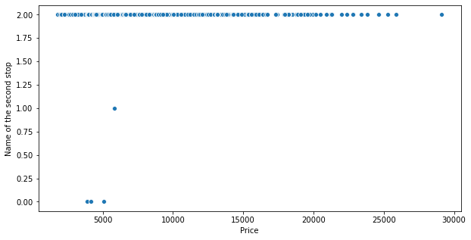
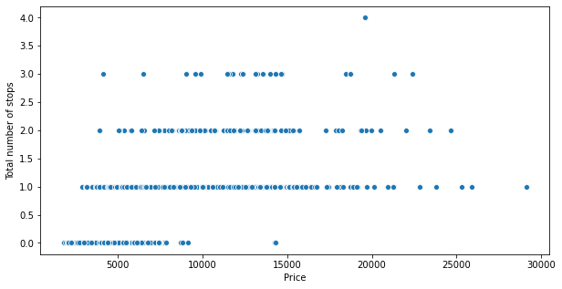

Slide 32
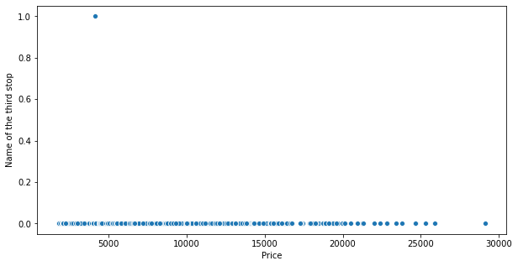
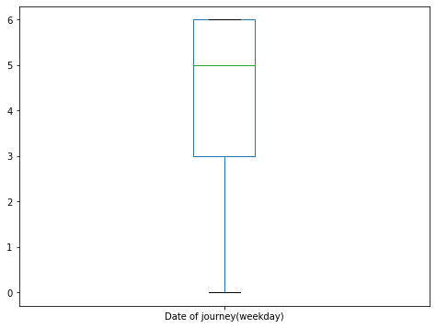
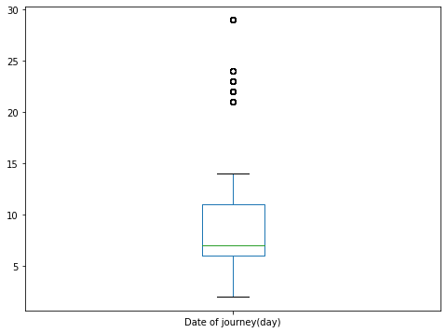
Box plots

Slide 33





Slide 34





Slide 35
Steps and assumption.
In the column date of journey(weekdays), the numbers represent the following days of week, i.e., Friday is represented by 0, Saturday by 1, Sunday by 2, Monday by 3, Tuesday by 4, Wednesday by 5 and Thursday by 6.
The non-stop in total number of stops is replaced by 0.
In the column Airline name ‘air asia’ and ‘airasia’ are the same.
The name of the city Bengaluru and Bangalore are the same.
The date of scrapping the data from the web was 6th October 2021

Slide 36

Model selection
Linear Regression

Slide 37

Model selection
Decision Tree Regressor

Slide 38

Model selection
Random Forest Regressor

Slide 39

Model selection
KNNeighbors Regressor

Slide 40

Model selection
Gradient Boosting Regressor

Slide 41

Final Model
Random Forest Regressor(after hyperparameter tuning)

Slide 42

Final Model
Random Forest Regressor(after hyperparameter tuning)

Slide 43
Conclusion
Optimal timing for airline ticket purchasing from the consumer’s perspective is challenging principally because buyers have insufficient information for reasoning about future price movements. In this project we majorly targeted to uncover underlying trends of flight prices in India using historical data and also to suggest the best time to buy a flight ticket.
Nowadays, airline ticket prices can vary dynamically and significantly for the same flight, even for nearby seats within the same cabin. Customers are seeking to get the lowest price while airlines are trying to keep their overall revenue as high as possible and maximize their profit. Therefore various models are proposed to save money for customers: models that predict the optimal time to buy a ticket and models that predict the minimum ticket price.
By performing different models, it was aimed to get different perspectives and eventually compared their performance. With this study, it purpose was to predict prices of flights. For this project, we have collected data from 10 routes across India. The dataset contains 18 columns and 2204 rows after cleaning. With the help of the data visualizations and exploratory data analysis, the dataset was uncovered and features were explored deeply.

Slide 44
Conclusion
The relation between features were examined. At the last stage, predictive models were applied to predict price of cars in an order: random forest, linear regression, KNeighbors regression, Decision Tree Regression, Gradient Boosting regression.
During this project I learnt a lot about new algorithms, data cleaning process, data scaling, normalization of data using various techniques. the data visualization process, especially count plot in the beginning helped me understanding the dataset. Further by using scatter plot I got to know relationship of different feature with target variables in less time and more effectively. The other visualisation techniques, like box plot, histogram, distribution plot, heat maps help in getting more information in less time and are effective and efficient also.
While finalising the model for the project I used basic parameters to check the efficiency of each model. However, Random Forest algorithm was best among the others. After doing hyperparameter tuning of the model, I found that the random forest regressor works best in the parameters{'bootstrap': False, 'criterion': 'mse', 'max_depth': 10,'max_features': 'sqrt', 'min_samples_leaf': 2, 'min_samples_split': 10, 'n_estimators': 100}.

